Slide 1
Section 5.5 Proportional Length and Areas of Triangles
© Copyright all rights reserved to Homework depot: www.BCMath.ca

Slide 2
I) Review: Triangles with equal height/base:
The area of a triangle is equal to the base times the height divided by 2
The base and height of a triangle must always be perpendicular!!
If the base and height of two triangles are the same, their areas must be the same
If these triangles all have equal bases, their areas will be equal

Slide 3
Note: This is one of the hardest lessons in Math 8 Honours but is also one of the most useful lessons too
Main Concept: when two triangles have the same height, the ratios of the bases will dictate the ratios of the areas
Suppose you have two triangles shown below, these two triangles have the same height and the ratios of their bases is “m” to “k”
The ratios of their bases is m:k
The ratios of their areas will be:
Here’s a sample of how this concept can be applied:
The ratios of their bases is 6:5
The ratios of their areas will also be 6:5

Slide 4
Ex: If area of ∆ABC is 20cm² and the ratio of BC to CD is 5:3, then what is the area of ∆ABD?
Ex: Use the ratios of the bases or areas to find the missing length or areas
20m²

Slide 5
Ex: If area of ∆ABC is 20cm² and the ratio of BC to CD is 5:3, then what is the area of ∆ABD?
Use the ratios of the bases to find A₂.
Then add the areas of both triangles to find the area of the large triangle
So ∆ABD will be the sum of the two triangles: ∆ABD = ∆ABC + ∆ACD = 32cm²

Slide 6
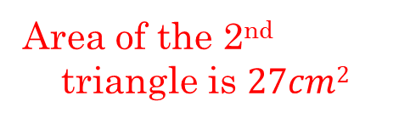

Ex: Use the ratios of the bases or areas to find the missing length or areas
1st: Both triangles have the same height
Use the left side as the bases of both triangles!
2nd: Use the bases of the two triangles for the ratio between the areas
Ratio of the bases:
Ratio of the Areas:
Ratio of the bases:
Ratio of the Areas:
Area of the 2nd triangle is $27cm2$
Area of the 2nd triangle is $26.\overline{6}cm2$

Slide 7
Now use the right side of the triangle as the base
20m²
The blue triangle and A₂ have the same height, so the ratio of their bases will be the same ratio as their areas
Use the left side of the triangle as the base to get the area of A₁
The green and purple triangles have the same height
The area A₁ is 36m² and the area of A₂ is 40m²
Now we have the area of the two top triangles combined

Slide 8
Use BD as the base for the three triangles on the left!
ABCD is a rectangle and the top 3 triangles is equal to half the area of the rectangle
Since EF and BD are equal, then the areas of triangle AEF and AFB are equal!!
Area of triangle ABD is then equal to 4 + 8 + 8 = 20m²
We are given that EF is twice as long as DE, then the area of triangle ADE is half of AEF.
So the area of triangle BCD is then also equal to 20m²

Slide 9
II) Extensions of Triangles with the same Bases
The bases of the two triangles A1 and A2 have a ratio of 3:2, so the areas will also have the ratios of 3:2
Suppose we extend If we extend the height of both triangles, the ratios of the areas will be consistent with 3:2
Now suppose we want to compare the ratios of these two triangles: A5 and A6, what would the ratio of their areas???
The ratios of the extended triangles will also stay consistent with the ratio of the bases
The ratios of A3 to A4 will also be 3:2
The ratios of A5 to A6 will also be 3:2

Slide 10
Ex: Find the missing areas of the indicated triangles:

Slide 11


Ex: Find the missing areas of the indicated triangles:
The ratio of the bases are given as 4:3
This ratio should be equal to the ratio of the areas for the following triangles:
Area of the 1st triangle A₁ is $24cm2$
Area of the 2nd triangle A₂ is $15cm2$

Slide 12


Use the left side of the triangle as the base
Use the ratio of the bases to get the areas of the missing triangles
Area of the 1st triangle A₁ is $55cm2$
Area of the 2nd triangle A₂ is $44cm2$

Slide 14
III) Proportional Areas with Trapezoids
The top and bottom sides of a trapezoid are parallel
The triangle on top and the one below are similar (AAA)
Let “x” and “y” be the side lengths of the top and bottom
Since the triangles are similar, the ratios of their areas will be:
The ratios of corresponding sides will also be x:y
The left two triangles have the same height, the ratio of their base is x:y
If the entire process is repeated with the two right triangles, we can see that the ratio of the right triangle is also xy
Base
Area

Slide 15
Ex: Find the length of the missing sides and area of A_{l} and A₂ :

Slide 16
Ex: Find the length of the missing sides and area of A_{l} and A₂ :
The ratio of the top and bottom triangles is 25 to 49
We have two triangles given, the ratio of their areas are:
“Square root” the values of this ratio and we will get the ratio of x:y
Reduce this ratio to get the ratio of x:y
With the ratio of x:y found, we can get the ratio of the four triangles
The ratio of x:y is 3 to 5, so use this to find A2
Left triangle and right triangle are always equal

Slide 17
Ex: Find the length of the missing sides and area of A_{l} and A₂ :
A₁ is easy, A₁ is 12m²
Find the ratio of x:y by reducing the ratio of the left and bottom triangles
Use the ratio of x to y to find A2 and the bottom side

Slide 18
Q2: Given that the area of the trapezoid is 120cm² and lengths of the top and bottom sides, find the areas of A_{l}, A₂, A₃ and A₄:

Slide 19
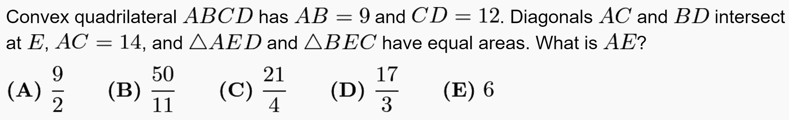
AMC 12 2009a
Start the question by doing your best to create a diagram
We know that it an trapezoid b/c the left and right triangles have the same area
We know that ABCD is a quadrilateral. CD>AB
Since we have the top and bottom sides, we know that ratio of x:y is 9:12 or 3:4
So the ratio of AE to EC is also 3:4
The answer to this question is “E”, AE = 6

Slide 20
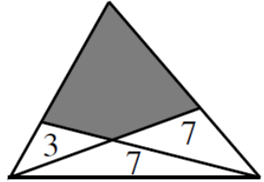



`
IF this green line was the base, the ratio of the bases of the two bottom triangles will be 3:7
If we drew a line to the top, it would create two triangles above it, their ratios will also be 3:7
Suppose we used another line as the base, “RED”, the ratio of the two triangles above will be 7:7
The answer to this question is “D”, M+N = 18
Divide the shaded region into two separate parts, assign each a variable. Use the ratios to find the areas

